Slide 1

School of Computing Science and Engineering
School of Computing Science and Engineering
Program Name: BTech , 5 SEM
Course Code : E2UC502T
Course Name : Software Testing & Quality Assurance
Module 2

Slide 2
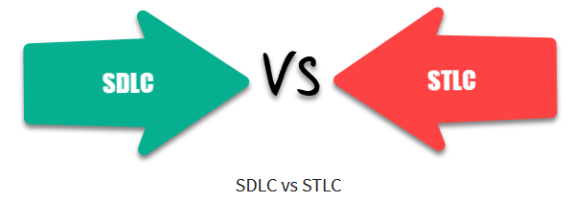
School of Computing Science and Engineering
“SDLC Vs STLC"
SDLC Vs. STLC
Software Development Life Cycle (SDLC) defines all the standard phases which are involved during the software development process, whereas the Software Testing Life Cycle (STLC) process defines various activities to improve the quality of the product.
SDLC is a Development Life Cycle, whereas STLC is a Testing Life Cycle.
In SDLC, the development team creates the high and low-level design plans, while In STLC, the test analyst creates the System, Integration Test Plan
In SDLC, real code is developed, and actual work takes place as per the design documents, whereas in STLC testing team prepares the test environment and executes test cases.
The SDLC life cycle helps a team complete the software’s successful development, while the STLC phases only cover software testing.

Slide 3
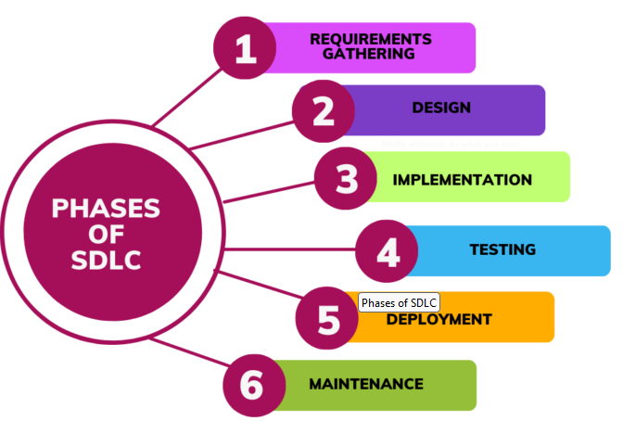
School of Computing Science and Engineering
“SDLC Vs STLC"
What is SDLC?
Software Development Life Cycle (SDLC) defines all the standard phases which are involved during the software development process. SDLC life cycle is a process of developing software through a phased manner in the following order
Requirements Gathering
Design the software
Implementation
Testing
Deployment
Maintenance
Each stage has definite entry and exit criteria along with deliverables.

Slide 4
School of Computing Science and Engineering
“SDLC Vs STLC"
What is SDLC?
Requirements Gathering and Analysis: During this phase, development teams and project stakeholders collect and scrutinize the requirements for the software project. The main objective is to understand the expectations and necessities of the end-users or customers.
Design: In this phase stage, the system elements, software architecture, and UI (user interface) are planned and documented. The design phase helps create a blueprint for the development process.
Implementation (Coding): This stage includes the actual software development based on the design specifications. Developers write the code following best practices and coding standards.
Testing: The testing phase mainly aims to detect and fix defects/ glitches in the code. Various forms of testing, like system testing, integration testing, and unit testing are directed to ensure that the software functions as proposed.
Deployment: Once the software product has passed all testing stages and meets the necessary quality standards, it is released or deployed to clientele or end-users for use.
Maintenance: The maintenance phase mainly involves giving ongoing updates, support, and bug fixes to the software product to guarantee its sustained smooth operation.

Slide 5
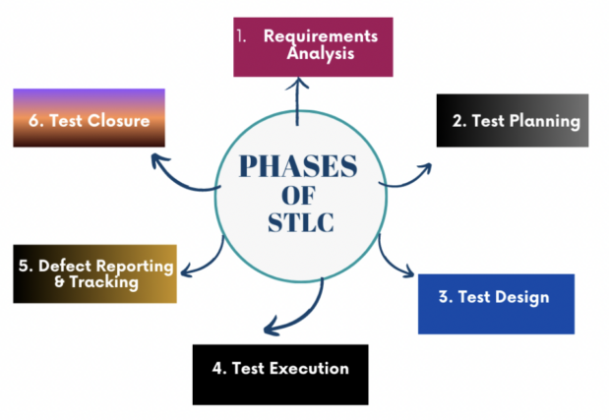
School of Computing Science and Engineering
“SDLC Vs STLC"
What is STLC?
Software Testing Life Cycle (STLC) is the testing process that is executed in a well-planned manner. In the STLC process, various activities are carried out to improve the quality of the product. However, STLC phases only deal with testing and detecting errors but not development itself.
Different companies define different phases in STLC. However, generic Software Test Life Cycle has the following stages.
Requirement Analysis
Test Planning
Test Design
Test Execution
Defect Reporting & Tracking
Test Closure

Slide 6
School of Computing Science and Engineering
“SDLC Vs STLC"
What is STLC?
Requirements Analysis: During this stage, the BRD (business requirements document) formed in the SDLC requirements stage is analyzed by the QA team so that they comprehend the key functionality and outcomes that are needed from the newest system.
Test Planning: Once the functionality and results are understood, the QA team will commence planning how they are going to plan their tests. The test planning stage includes generating a comprehensive test strategy & plan. Test scope, objectives, timelines, as well as resources are defined in this phase. It lays the foundation for the complete test procedures.
Test Design: In this particular phase, test scripts and test cases are designed based on the software requirements & design. QA engineers create test cases to check the functionality and confirm the complete test coverage of the software.

Slide 7
School of Computing Science and Engineering
“SDLC Vs STLC"
What is STLC?
A test Scripts are step-by-step instructions on how to test a test case. They are detailed and contain individual steps that test for each and every functionality.
For example, to check the login function on a website, your test script might do the following: Specify how the automation tool can locate the “Username” and “Password” fields in the login screen. Let us say, by their CSS element IDs. Load the website homepage, then click on the “login” link.
A test case is a set of actions performed on a system to determine if it satisfies software requirements and functions correctly. The purpose of a test case is to determine if different features within a system are performing as expected and to confirm that the system satisfies all related standards, guidelines and customer requirements. The process of writing a test case can also help reveal errors or defects within the system.

Slide 8
School of Computing Science and Engineering
“SDLC Vs STLC"
What is STLC?
Test Execution: This stage counts running the test scripts and cases on the software. Testers implement the tests and record the outcomes. Bugs or issues found during tests are logged for further examination and resolution.
Defect Reporting & Tracking: In the defect reporting and tracking stage, QA’s report the recognized defects in a defect tracking system. The errors/ defects are assigned to develop (development) team for fixing. QA engineers then track the defects’ status and validate fixes after they are executed.
Test Closure: In the test closure stage, the test outcome is prudently scrutinized and test summary reports are prepared. The expert QA team assesses whether the software meets the test goals and if it is all set for deployment. The test summary reports are then presented to stakeholders for review.

Slide 9
School of Computing Science and Engineering
“SDLC Vs STLC"
Why Use SDLC?
Here, are some prime reasons for using SDLC method:
It aims to produce a high-quality software system which helps you to meet the customer expectations.
A formal review is created after completion of every stage that provides optimum management control.
SDLC helps you to create considerable system documentation.
It produces many intermediate products which can be reviewed to verify whether they can meet the user’s needs and are according to the stated requirement.
SDLC helps you to ensures that system requirements can be traced back to stated business requirements.
Every phase has a specific deliverable, entry and exit criteria.
Development stages go one by one which is an ideal option for the small or mid-sized projects where requirements are clear.

Slide 10
School of Computing Science and Engineering
“SDLC Vs STLC"
Why STLC?
Here, are Important reasons for using STLC method:
STLC helps make the testing process more sophisticated, consistent and effective.
You can include milestones and deliverables for each step of the project.
Easy to understand and implement even if the model is expanded to various levels.
Time constraints are strongly built in project formulation.
Each module of the project is tested before the beginning of the another module.
The requirement of the specific project is measured against the actual result.

Slide 11
School of Computing Science and Engineering
“SDLC Vs STLC"
Features of SDLC
The model structure & functions are well documented, and the tested result is readily available.
The project can be completed step by step before another project begun. Project units are distinct and easily identifiable.
Risk management is integral to the model and is handled efficiently.
The project can be designed so that the pieces should be sourced.
Features of STLC
STLC analyze system requirements collected from clients and stakeholders.
Identify the testing technique and testing types.
Prioritize the feature which should be primarily targeted on the test.
You can Analyze the Automation feasibility with STLC.
Identify the information about the testing environment where the actual test should be executed.

Slide 12
School of Computing Science and Engineering
“Test Case"
Test Case
A test case is a defined format for software testing required to check if a particular application/software is working or not.
A test case consists of a certain set of conditions that need to be checked to test an application or software i.e. in more simple terms when conditions are checked it checks if the resultant output meets with the expected output or not.
A test case consists of various parameters such as Id, condition, steps, input, expected result, result, status, and remarks.

Slide 13
School of Computing Science and Engineering
“Test Case"
Parameters of a Test Case:
Module Name: Subject or title that defines the functionality of the test.
Test Case Id: A unique identifier assigned to every single condition in a test case.
Tester Name: The name of the person who would be carrying out the test.
Test scenario: The test scenario provides a brief description to the tester, as in providing a small overview to know about what needs to be performed and the small features, and components of the test.
Test Case Description: The condition required to be checked for a given software. for eg. Check if only numbers validation is working or not for an age input box.
Test Steps: Steps to be performed for the checking of the condition.

Slide 14
School of Computing Science and Engineering
“Test Case"
Parameters of a Test Case:
Prerequisite: The conditions required to be fulfilled before the start of the test process.
Test Priority: As the name suggests gives the priority to the test cases as in which had to be performed first, or are more important and which could be performed later.
Test Data: The inputs to be taken while checking for the conditions.
Test Expected Result: The output which should be expected at the end of the test.
Test parameters: Parameters assigned to a particular test case.
Actual Result: The output that is displayed at the end.
Environment Information: The environment in which the test is being performed, such as the operating system, security information, the software name, software version, etc.
Status: The status of tests such as pass, fail, NA, etc.
Comments: Remarks on the test regarding the test for the betterment of the software.

Slide 15
School of Computing Science and Engineering
“Test Case"
When do we Write Test Cases?
Test cases are written in different situations:
Before development: Test cases could be written before the actual coding as that would help to identify the requirement of the product/software and carry out the test later when the product/software once gets developed.
After development: Test cases are also written directly after coming up with a product/software or after developing the feature but before the launching of a product/software as needed to test the working of that particular feature.
During development: Test cases are sometimes written during the development time, parallelly. so whenever a part of the module/software gets developed it gets tested as well.

Slide 16
School of Computing Science and Engineering
“Test Case"
Why to Write Test Cases?
To check whether the software meets customer expectations: Test cases help to check if a particular module/software is meeting the specified requirement or not.
To check software consistency with conditions: Test cases determine if a particular module/software work with a given set of conditions.
Narrow down software updates: Test cases help to narrow down the software needs and required updates.
Better test coverage: Test cases helps to make sure that all possible scenarios are covered and documented.
For consistency in test execution: Test cases help to maintain consistency in test execution. A well-documented test case helps the tester to just have a look at the test case and start testing the application.
Helpful during maintenance: Test cases are detailed which makes them helpful during the maintenance phase.

Slide 17
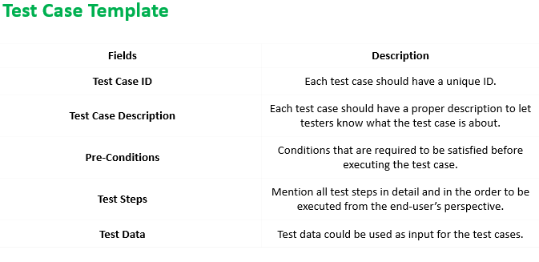
School of Computing Science and Engineering
“Test Case"
Test Case Template

Slide 18
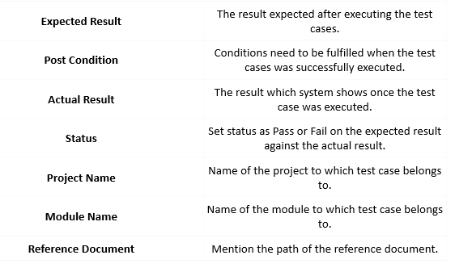
School of Computing Science and Engineering
“Test Case"
Test Case Template

Slide 19
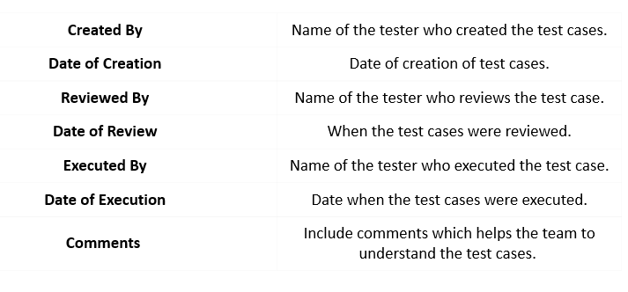
School of Computing Science and Engineering
“Test Case"
Test Case Template

Slide 20
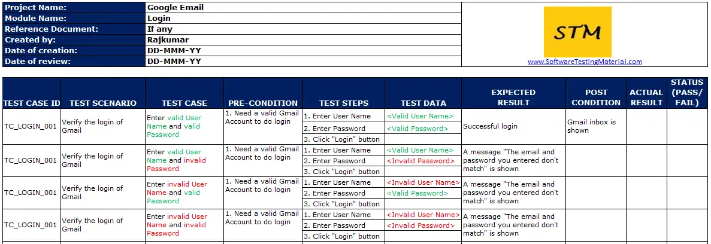
School of Computing Science and Engineering
“Test Case"
Sample Test Cases

Slide 21
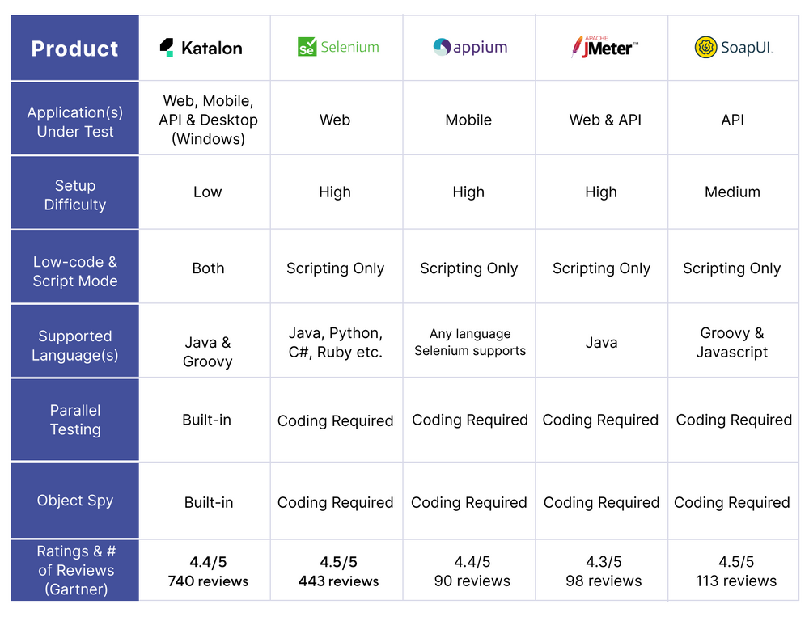
School of Computing Science and Engineering
“Test Case"
Test Case Tools

Slide 22
School of Computing Science and Engineering
“Test Deliverables”
What are Test Deliverables?
Test Deliverables are the artifacts which are given to the stakeholders of software project during the software development life cycle.
There are different test deliverables at every phase of the software development life cycle.
Some test deliverables are provided before testing phase, some are provided during the testing phase and some after the testing cycles is over.

Slide 23
School of Computing Science and Engineering
“Deliverables”
The different types of Test deliverables are:
Test Case Document
A test document is a document of artifacts created before or during software Testing. It helps the testing team estimate the effort needed, test coverage, resource tracking, execution progress, etc. It is a complete suite of documents that allows you to describe and document test planning, test design, test execution, and test results drawn from the testing activity.

Slide 24
School of Computing Science and Engineering
“Deliverables”
The different types of Test deliverables are:
Test Log
Test logging and test reporting are an integral part of the Software Testing Life Cycle. A test log is a vital component of test reporting because it provides the detailed information needed to support the conclusions and insights presented in the test report.

Slide 25
School of Computing Science and Engineering
“Deliverables”
The different types of Test deliverables are:
Test Strategy
Test strategy will be decided based on the Business requirement specification. It is a vital document that contains all the details of the testing work to be carried on. It is a complete management document.
When compared to the test plan, this is a high-level document and is usually prepared by the Test manager or lead. Test objective, test approach, test scope, entry & exit criteria, types & levels of testing, milestones, staffing, etc. must be mentioned here.

Slide 26
School of Computing Science and Engineering
“Deliverables, Version and Error Control”
The different types of Test deliverables are:
Test Plan and Estimation
A test plan is a document that consists of all future testing-related activities. It is prepared at the project level, and in general, it defines work products to be tested, how they will be tested, and test type distribution among the testers.
The granular level details for each step of testing should be mentioned here. In general, a proper plan leads to a proper work structure. Similarly, a good plan leads to good testing.
The Test objective, test approach, test scope, entry & exit criteria, types & levels of testing, milestones, staffing, etc. should be mentioned here in a detailed manner.
The master plan which includes how testing is to be carried is used for simple projects.
Estimation: Estimation is defining how long each step will occur in testing along with the overall cost.

Slide 27
School of Computing Science and Engineering
“Deliverables”
The different types of Test deliverables are:
Test Scenario
We will understand this with an example now. Let us take the train reservation as an example here. All the functionalities that we need to test are mentioned in high-level forms in the test scenario document. In simple words, it means a group of similar activities to be performed.
Two Techniques for the scenario:
1) Use case
2) ACE (Activity Component Element)

Slide 28
School of Computing Science and Engineering
“Deliverables”
Two Techniques for the scenario:
1) Use case
It is the goal-oriented method which is a set of interactions between the external factors and the system. Its components include primary flow, alternate flow, triggers or activities, exception flows, pre-conditions, post-conditions, etc.

Slide 29
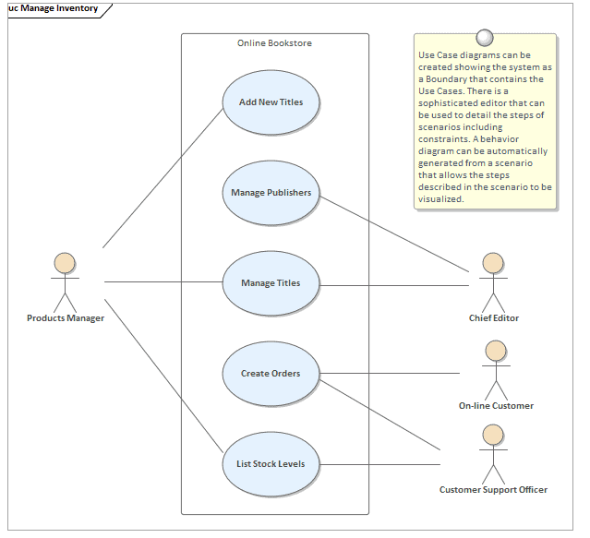
School of Computing Science and Engineering
“Deliverables”
Use case Diagram

Slide 30
School of Computing Science and Engineering
“Deliverables”
Two Techniques for the scenario:
2) ACE (Activity Component Element)
The Activity Component Element process breaks the business requirements into activities.
Example:
In general, we book a ticket by filling in the passenger details, gender, etc. Hence we need to validate the following fields which thereby become scenarios.
Reservation: Check the reservation functionality.
Passenger details: Check the name, age, and sex fields functionality.
Modify: Check if the modified functionality works properly.

Slide 31
School of Computing Science and Engineering
“Deliverables”
Concession: Check if the concession functionality works properly.
View: Check if the view functionality works properly.
Cancel: Check if the cancel functionality works properly.
Here, the concession may be called as an “alternate scenario” as the user can book with or without it based on age. However, the goal is the same i.e. to book a ticket.

Slide 32
School of Computing Science and Engineering
“Deliverables”
Test Case
By taking the same above example of the reservation page, the test cases are written as follows:
Reservation:
Check if the user can book a ticket by filling in valid details in all the fields.
Check if the user can book a ticket by filling invalid details in all the fields.
Check if the user can book a ticket by leaving any blank field.

Slide 33
School of Computing Science and Engineering
“Deliverables”
Passenger details:
Check if the user can book a ticket by entering a valid name.
Check if the user can book a ticket by entering an invalid name.
Check if the user can book a ticket by choosing any one gender at a time.
Check if the user can book a ticket by entering an age greater than 60.
Check if the user can book a ticket by entering an age less than 60.
Check if the user can book a ticket by entering any valid age greater than 5.
Check if the user is not able to book by entering an age less than 5.

Slide 34
School of Computing Science and Engineering
“Deliverables”
Modify:
Check if the user can modify the name field.
Check if the user can modify the gender field.
Check if the user can modify the age field.
Concession:
Check if the user can get a concession by selecting the “Senior citizen” option.
Check if the user can get a concession by selecting the “Handicapped/Disabled” option.

Slide 35
School of Computing Science and Engineering
“Deliverables”
View:
Check if the user can view the ticket reserved.
Cancel:
Check if the user can cancel the ticket.
Thus test cases tell what exactly needs to be tested in detail. Test cases have to be written in simple language and should be easily understandable. It should be written in proper format as asked by the concerned client.

Slide 36
School of Computing Science and Engineering
“Deliverables”
Test Data
Some project needs prior data from the client before proceeding with the execution of the test case. Test data need to be applied to perform testing.
Example: In the hospital portal for getting an injection, it is important to get the patient details to check the injection reminder option.
Here the “patient details” is the test data.

Slide 37
School of Computing Science and Engineering
“Deliverables”
RTM/ Requirement Traceability Matrix
As the name implies, it simply means that you have to map every requirement with the appropriate test case.
It helps us in checking if we have covered all the requirements in our test cases or not.
It helps in rework or the next successive releases of a project.
The client can easily check our coverage status and know our testing process.
By using this document, one can verify test cases cover all functionality of the application as per the requirements of the customer.

Slide 38
School of Computing Science and Engineering
“Deliverables”
Test Summary Report
Test Report is a document that contains a summary of all test activities and final test results of a testing project. The test report is an assessment of how well the Testing is performed. Based on the test report, stakeholders can evaluate the quality of the tested product and decide on the software release.
Test Summary Report summarizes all the test activities done and the test results are compiled in it. All the test information such as members involved in testing, objectives, scope, client details, test approach used, test results, defect report, etc. should be mentioned here.
However, the test summary report should be prepared as per the client’s advice. Thus it is a useful document for the client as well to review the overall performance.

Slide 39
School of Computing Science and Engineering
“Deliverables”
Test Closure Report
It means that we are going to close the project after testing and defect fixing. Thus here we have to provide a detailed analysis of the execution of the tests.
The defects found, and fixed must be mentioned here. The overall requirement coverage is seen in this report. It is generally prepared by the team lead or manager.
All the exit criteria should be satisfied accordingly.

Slide 40
School of Computing Science and Engineering
“Deliverables”
Incident Report
While performing formation execution if a user finds defects, then an Incident report (IR) should be raised. This means that there is a defect and thus the execution has to be stopped. We now need to raise an incident report to the client for asking them permission to execute the error areas again as a separate test case.
This indeed is a black mark and is not expected from a tester. All the defects have to be found in the dry run itself. If it is missed and found in formal execution, then it becomes an IR.

Slide 41
School of Computing Science and Engineering
“Deliverables”
Incident Report
Example:
If I miss certain functionality in mobile testing say the “screensaver change” option. Then while executing a test case I get locked and I will not be able to proceed further because of this option. Then I raise an IR and write a separate test case to execute the screensaver option.

Slide 42
School of Computing Science and Engineering
“Deliverables”
Defect Report
A defect report is a document that has concise details about what defects are identified, what action steps make the defects show up, and what are the expected results instead of the application showing error (defect) while taking particular step-by-step actions.
Release Notes
Release notes are a document that is released as part of the final build that contains new enhancements that went in as part of that release and also the known issues of that build. Technical writers usually write Release Notes and communication documents shared with clients. Release notes also feed the process of end-user documentation, user guides, and training materials.
Conclusion
The artifacts that are sent to the stakeholders of a software project during the STLC are known as Test Deliverables.

Slide 43
School of Computing Science and Engineering
“Version”
Version
Versioning is the creation and management of multiple product releases, all of which have the same general function, but are improved, upgraded or customized.
While many developers and vendors use the term in different contexts, versioning most often applies to operating systems, software artifacts and web services.

Slide 44
School of Computing Science and Engineering
“Error Control”
Error Control
Error handling testing is a type of software testing that is performed to check whether the system is capable of or able to handle the errors that may happen in future. This type of testing is basically performed with the help of both developers and the testers.
Error handling testing not only focuses on the determination of error but also focuses on the exception handling.
Objective of Error Handling Testing
The objective of error handling testing is:
To check the system ability to handle errors.
To check the system highest soak point.
To make sure errors can be handles properly by the system in the future.
To make system capable of exception handling also.

Slide 45
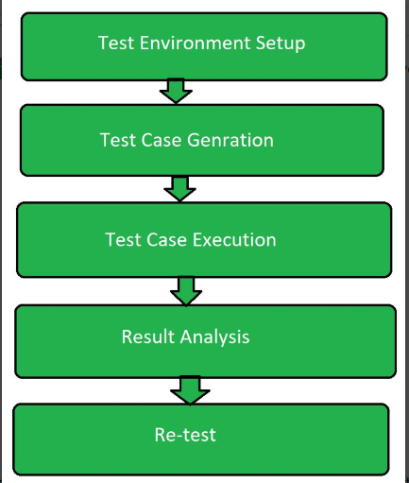
School of Computing Science and Engineering
“Error Control”
Error Control
Steps involved in the Error Handling testing:

Slide 46
School of Computing Science and Engineering
“Error Control”
Steps
Test Environment Set Up: Test environment is set according to the software testing technique so that the testing process can run smoothly. This step includes planning for the testing. System which is going to be tested is made sure have less significant data as there might be crash problem in the system during testing.
Test Case Generation: In this software testing test case generation is nothing but making different test cases which may cause error. Suppose a software operates on fractions then setting the denominator of the fractions as zero. Test case generation is associated with the developing team as without knowing the internal code, test cases can’t be designed.

Slide 47
School of Computing Science and Engineering
“Error Control”
Steps
Test Case Execution: After the test case generation, real testing process begins. This is the most prominent part of the testing process. It includes the running the program over the test case generated.
Result and Analysis: After the execution of the test case, its result is analyzed. It included the checking of the inconsistency in the expected output for the generated test case. There might be a chance of the program going into an infinite loop which may lead to software failure.
Re-test: If the testing is failed then after the analysis once more all the above steps are performed to test the system. It includes the testing of the system under new test cases generated recently.

Slide 48
School of Computing Science and Engineering
“Software Verification & Validation"
Introduction
Software verification and validation is a vital model that allows the team of software developers and testers ensure.
Both software verification and validation help create a software product.
What is software Verification ?
It is performed during the ongoing phase of software development.
Verification is the process of checking or verifying the credentials , data or information.
It is highly possible that a software product goes well through the verification process.

Slide 49
School of Computing Science and Engineering
“Software Verification & Validation"
Features of Software Verification
Performed during the early stages of the software development process to determine for the specific requirements.
Verification denotes precision of the end or final product.
It conducts software review , walk through , inspection, and evaluate documents.
Methods of Verification
Static Verification : Static verification involves inspection of the code.
Dynamic verification : It concerns with the working behaviour of the software.

Slide 50
School of Computing Science and Engineering
“Software Verification & Validation"
Features of Software Verification
Performed during the early stages of the software development process to determine for the specific requirements.
Verification denotes precision of the end or final product.
It conducts software review , walk through , inspection, and evaluate documents.
Methods of Verification
Static Verification : Static verification involves inspection of the code.
Dynamic verification : It concerns with the working behaviour of the software.

Slide 51
School of Computing Science and Engineering
“Software Verification & Validation"
Types of Reviews on the Basis of Stage Phase
Reviews
Walkthrough
Inspections
Requirements tracing
Static analysis

Slide 52
School of Computing Science and Engineering
“Software Verification & Validation"
Review in Testing Lifecycle
Testing –readiness review
Prerequisites training
Updation testing
Un –installation testing
Test -completion

Slide 53
School of Computing Science and Engineering
“Software Verification & Validation"
Coverage in Verification
Statement Coverage : Code includes many statements. Code are verified.
Path Coverage : Sequence of control flow from entry to exit.
Decision Coverage : When and application is executed ,it may have to make decisions based upon the situation it faces.
Assurance that the best verification techniques will be used.
Assurance that the verification techniques will be integrated.
Assurance that the technique will be executed properly.

Slide 54
School of Computing Science and Engineering
“Software Verification & Validation"
Coverage in Validation
Validation is an actual testing performed on the software product.
Gathering and analysis of the specifications and requirements,
Test the error message.
Boundary values along with stress and functionalities test.
Validation workbench basic requirements
Inputs
Output
Validation process
Check process
Standards , tools , guidelines

Slide 55
School of Computing Science and Engineering
“Software Verification & Validation"
Levels of validation
Unit testing : focuses verification efforts on the smallest unit of software design.
Unit test consideration : module interface is tested to ensure that information properly flows.
Coverage in validation
Requirement Coverage : All the requirements need not be necessarily covered.
Functional Coverage : At time , requirements are expressed in the functionality required for the application to work correctly.
Feature Coverage : It describes about covering a feature required by the user.

Slide 56
School of Computing Science and Engineering
“Software Verification & Validation"
Acceptance testing and types of acceptance
Acceptance testing is one of the last type of software testing .
It is conducted by a pool of targeted users to ensure the readiness and quality.
It is also referred to as red box testing.
There are two types of acceptance testing : Alpha testing and Beta testing
V Test Model
Testing is a lifecycle activity.
It begins when the proposal of software development made.
For every development activity, there is a testing activity attached with it.
Every phase of software development activities must consider corresponding testing activity associated with it.

Slide 57
School of Computing Science and Engineering
“Software Verification & Validation"
V Model for Software
Validation model explains the validation activities associated with different phases of software development.
Design phase is associated with interface testing which covers design.
Program –level designs are associated with integration testing.
All the code level to validate individuals units , unit testing is done.

Slide 58
School of Computing Science and Engineering
“Software Verification & Validation"
Testing During Requirements stage
This stage must cover all the requirements for the system . Verification of problem definition and requirements definition is the basis on which the system requirement specification is developed further.
Characteristics of good requirements : adequate , clear and verifiable ,testable.
Testing during test –planning phase
This phase includes defining a test strategy for the given application.
The test manager is responsible for defining test strategy .
Testing artifacts must be reviewed for their consistency.
Testing during design phase
Design is the backbone of any software application.
Design may be made by system architects or designers.
Design must reflect the requirements correctly.
Verification and validation consist of : Consistency with respect to requirements and analyze design for errors.

Slide 59
School of Computing Science and Engineering
“Software Verification & Validation"
Testing During Requirements stage
This stage must cover all the requirements for the system . Verification of problem definition and requirements definition is the basis on which the system requirement specification is developed further.
Characteristics of good requirements : adequate , clear and verifiable ,testable.
Testing during coding
Coding is the most vital stage in software development.
It is important for the organization to establish verification and validation of a code.
Aspects to be checked : coding standards implementation, Coding Optimization and Unit testing.

Slide 60
School of Computing Science and Engineering
“Software Verification & Validation"
VV model
VV model describes verification and validation activities associated with software development during the entire lifecycle.
Various activities associated with each phase of the software development lifecycle.
Requirements
Requirements verification
Requirements validation
Design
High level design are created by architects and low-level designs by the designers.
Design verification –the project team along with designer may walk through the design to find the completeness and give comments.
Design validation –validation of design occurs at two or more stages during the software development lifecycle.

Slide 61
School of Computing Science and Engineering
“Software Verification & Validation"
Coding
Coding is done by developers where the low-level designs are implemented.
Code verification-code review helps in identification of errors with respect to coding standards , indenting standards , commenting standards.
Code validation –validation of coding happens through unit testing where individual units are tested separately.

Slide 62
School of Computing Science and Engineering
“Software Verification & Validation"
Critical roles and responsibilities
Development: development team may be comprised of various roles under them. They may be performing various activities as per their roles and responsibilities at different stages.
Testing: testing includes test manager , test leads , and testers as per scope of testing , size of the project , and type of customer.
Customer: customer may be final user group , or people who are actually sponsoring the project .

Slide 63
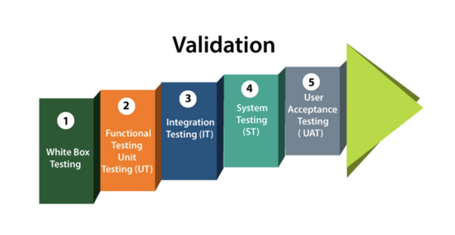
School of Computing Science and Engineering
“Software Verification & Validation"
What is Validation Testing?
The IEEE-STD-610 defines validation testing as “An activity that ensures that an end product stakeholder’s true needs and expectations are met.”
validation testing occurs at the end of a specific module or even after the software has been entirely built. Its primary intent is to ensure the final product matches the stakeholder and customer requirements.

Slide 64
School of Computing Science and Engineering
“Software Verification & Validation"
What is Validation Testing?
The IEEE-STD-610 defines validation testing as “An activity that ensures that an end product stakeholder’s true needs and expectations are met.”
validation testing occurs at the end of a specific module or even after the software has been entirely built. Its primary intent is to ensure the final product matches the stakeholder and customer requirements.

Slide 65
School of Computing Science and Engineering
“Software Verification & Validation"
Summary for Verification and Validation in Software Testing
Verification evaluates software artifacts (such as requirements, design, code, etc.) to ensure they meet the specified requirements and standards. It ensures the software is built according to the needs and design specifications.
Validation evaluates software to meet the user’s needs and requirements. It ensures the software fits its intended purpose and meets the user’s expectations.

